Slide 1
The battle of Neighborhoods in Benin
Viet Hoang Nguyen

Slide 2
Outline
Introduction
Goals
Methodology
Results
Discussion
Conclusion

Slide 3
Introduction
Benin occupation of lands
Growth of many activities in big cities
Geographic positions of those cities
Investors and Beninese preferred place of investments
Contrast between the north and south in term of the growth of infrastructures and services

Slide 4
Goals
The goals is to
Identify the venues in the neighborhood of two chosen regions one Banikoara (north) and another Abomey-Calavi (south).
Quantify the abounds of venues within these two selected regions
Highlight the potentiality and needs to develops big business in the north
The goal is of interest for Beninese, investors and entrepreneurs

Slide 5
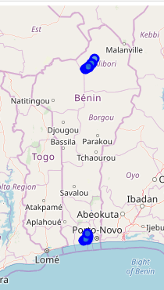
Goals
On the map we could see the geographic position of Banikoara and Abomey-Calavi each with their respective neighborhood. We obtained the information about the neighborhoods on the website of geopostcodes.com .

Slide 6
Methodology
We scrape the information available on Wikipedia about the department borough and region of Benin and create a data frame
We download a sample of dataset about the department and their neighborhood available at the website geopostcodes.com and merged it with the data frame obtained from Wikipedia
After creating respective data frame for Banikoara and Abomey-Calavi, we collected (via Foursquare API ) the venues within those regions in a radius of 50000 and clustered the neighborhood based on the frequency of occurrence of venues

Slide 7
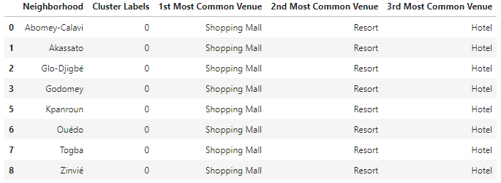
Results (1/4)
Run k-means to cluster the neighborhood into 2 clusters.
From the clustering of neighborhood in Abomey-Calavi we have more of big business such as shopping mall, resort and hotels venue.

Slide 8
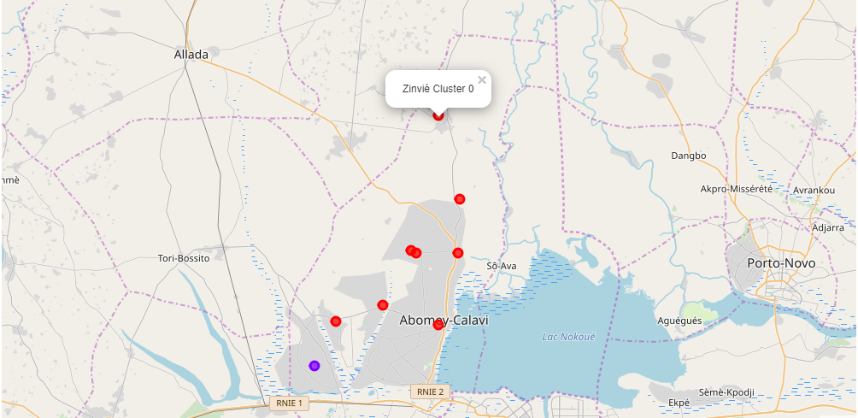
Results (2/4)
On a map we have the following view of the clustered neighborhoods within a radius of 50000 in Abomey-Calavi

Slide 9
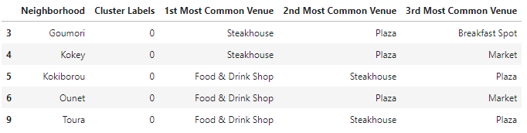
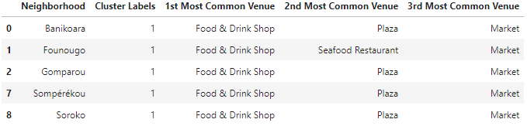
Results (3/4)
Run k-means to cluster the neighborhood into 2 clusters.
From the clustering of neighborhood in Banikoara we have more of small business such as of Food & Drinks shop, Plaza and Markets.

Slide 10
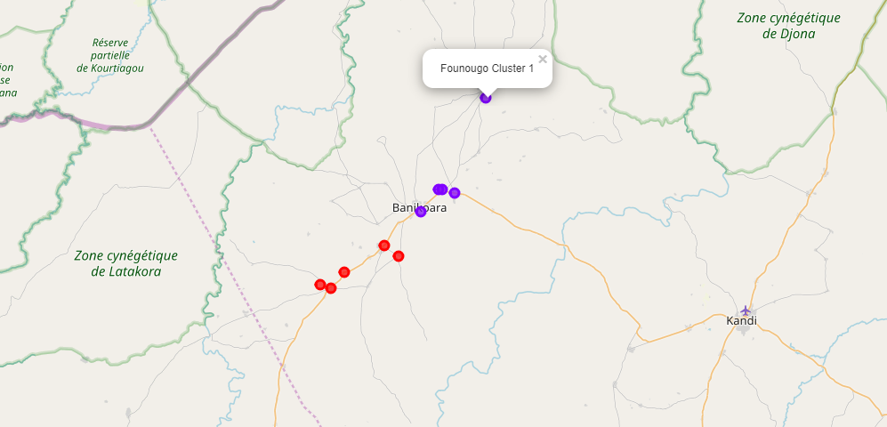
Results (4/4)
On a map we have the following view of the clustered neighborhoods within a radius of 50000 in Banikoara

Slide 11
Discussion
Quality of our dataset used for the geocoding of department, borough and neighborhood. sample dataset meaning we were limited in our search. With full list gear this study toward a comparison between the city of Cotonou and Parakou
Foursquare API to obtain the venues of each region. Too big radius. Query within a radius of 500 for concise and accurate result. Nevertheless necessary to geocode venues and places in the whole territory of Benin.
Clustered the neighborhood based on the frequency of occurrences of venues using K-means. Best if the choice of k was done using the elbow method. Plus due to the number of parameter to consider in characterizing small or big business we found in our clusters certain of our affirmation needs to be carefully scrutinize with more data at hand.

Slide 12
Conclusion
Banikoara northern part of Benin is the center of small business activities that revolves mainly around Food & Drinks Shop, Plaza and Markets.
Abomey-Calavi southern part we abounds of venues of Big Business such as : Shopping mall, Resort and Hotels
As a result, investors and Beninese are invited to explore for business opportunities in the north Benin this with respect of feasibility study and good marketing strategies for both winning party your business profits and the development of Benin.

